Slide 1
Project 1 - COVID-19 Vaccinations Trend Analysis
Mohit Bhupendra Jambhale

Slide 2
Agenda
Aim
Introduction
Problem Statement
Methodology
Analysis (Data sheets pertaining to it)
Insights
Recommendations
Conclusions

Slide 3
Aim
The aim of this project is to analyse the trend of COVID-19 vaccinations and to determine the effectiveness of the vaccines based on different countries and year and also the fully vaccinated people by country in 2021-2022.

Slide 4
Introduction
The COVID - 19 pandemic has had a wide -reaching impact on the world, and it has been necessary for governments around the world to take steps to mitigate the spread of the virus. Vaccination is one of the most effective ways to control the virus and has been implemented in many countries. In this project, we will analyse the trends of vaccination in different countries and to determine the effectiveness of the vaccine. By examining data, it shows total vaccinated peoples, daily vaccinated people’s details and also shows a website detail. Through the analysis of data, we can find the total vaccinated details.

Slide 5
Problem Statement
The COVID-19 pandemic has created an urgent need for a comprehensive analysis of vaccination trends to aid in the effective management of the vaccination campaigns. However, there is a lack of readily accessible and user-friendly tools to analyse and visualize COVID-19 vaccination data. This poses a significant challenge for policymakers, public health agencies, and researchers who require actionable insights to monitor the progress, identify bottlenecks, and make informed decisions regarding vaccination strategies.
To address this problem, the project aims to leverage Power BI, a powerful data visualization and analysis tool, to develop an interactive and intuitive platform for COVID-19 Vaccinations Trend Analysis. This platform will provide a centralized hub for collecting, analysing, and visualizing vaccination data, allowing stakeholders to gain valuable insights into the vaccination campaign's progress and impact.

Slide 6
Methodology
In this presentation, we will utilize Power BI Tool for data visualizations using the "Country_vaccinations.csv" dataset provided by Skill Lync. The methodology involves importing the data, performing data cleaning, creating a date table, establishing relationships between tables, selecting a theme, and creating various visualizations. Key visualizations include a card visual showing metrics like fully vaccinated people and total vaccinations, a line graph depicting the trend of people vaccinated over time, clustered column charts displaying the top 10 countries by fully vaccinated people and daily vaccinations, and a map visual representing total vaccinations by country. These visualizations provide meaningful insights into the vaccination process across different countries.

Slide 7
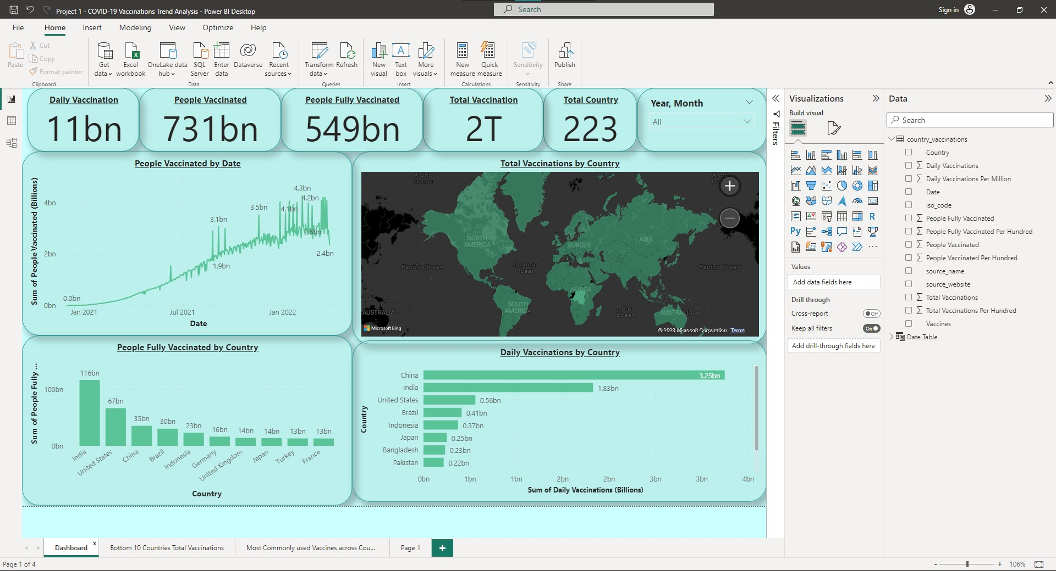

Slide 8
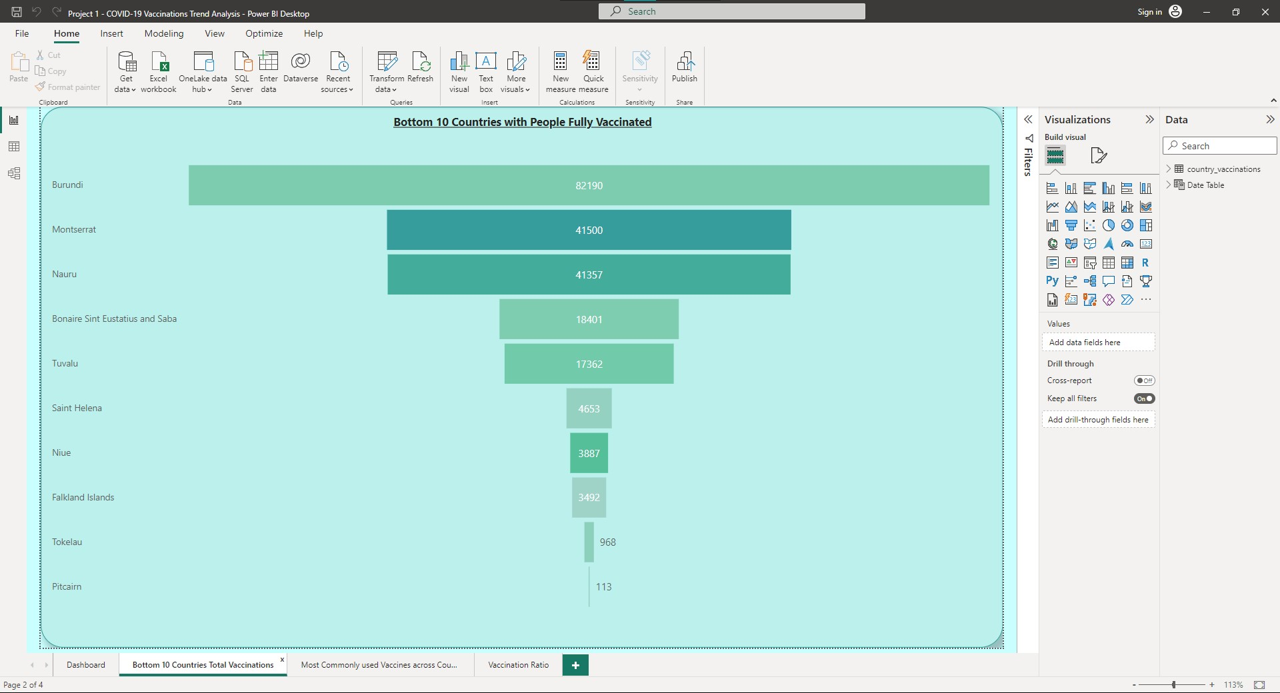

Slide 9
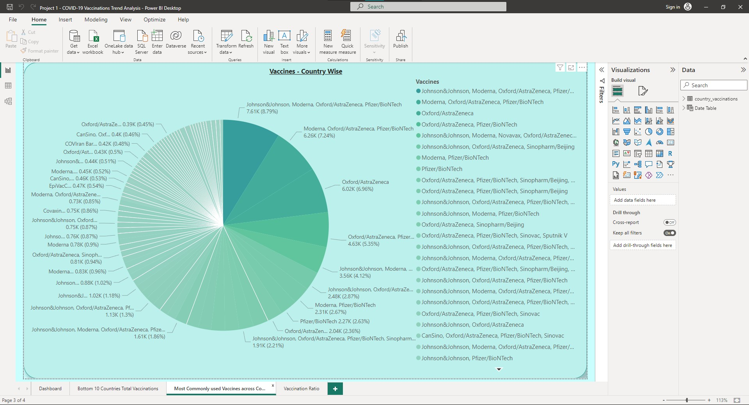

Slide 10
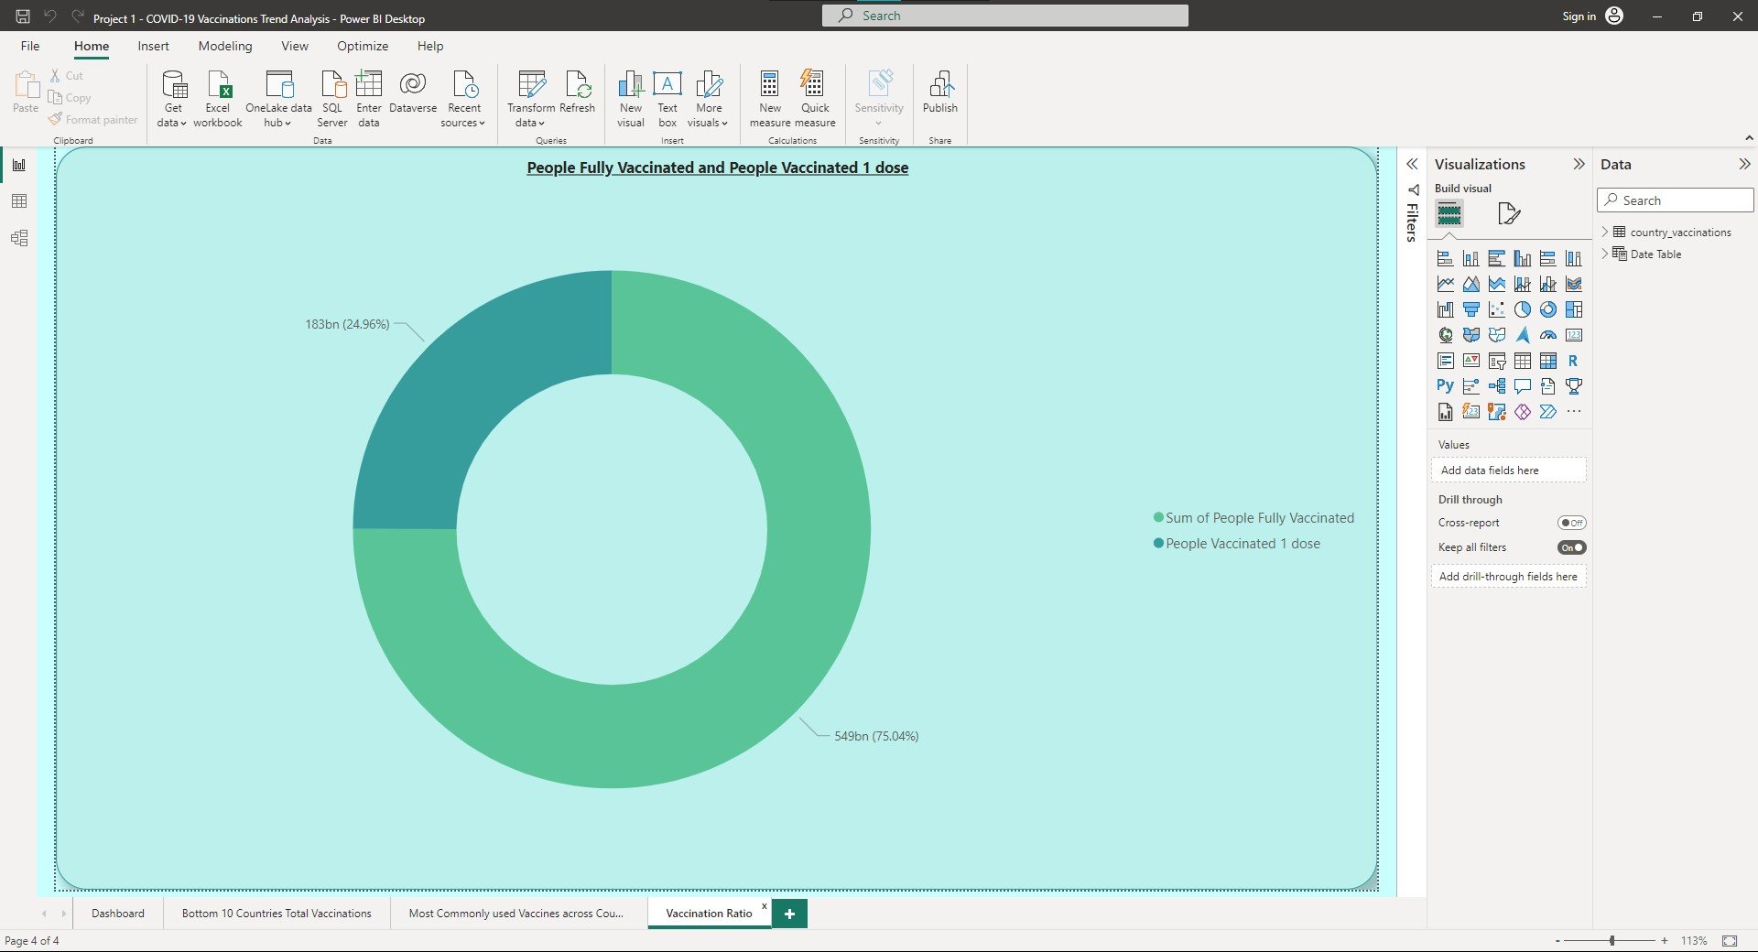

Slide 11
Analysis (Data sheets pertaining to it)
Analysis based on data sheets revealed interesting findings:
The data covers the years 2020, 2021, and 2022.
Map visualization shows total vaccinations by country.
China recorded the highest daily vaccination rate of 3.25 billion.
The total sum of vaccinations is 2 trillion.
The total number of people fully vaccinated is 549 billion.

Slide 12
Insights
India leads the country rankings for fully vaccinated population, with the United States in second place and China in third.
The bar chart illustrates the comparative performance of countries, with India at the forefront, followed closely by the United States and China.
China currently holds the top position in daily vaccinations, with India in second place and the USA in third.
Pitcairn, Tokelau, and Falkland Islands have the lowest fully vaccinated population, according to the bar chart.
Johnson & Johnson, Moderna, Oxford/AstraZeneca, and Pfizer/BioNTech are the most commonly used vaccines, as depicted by the donut chart. The line graph shows the peak vaccination rate in February 2022.

Slide 13
Recommendations
Investigate successful vaccination strategies in India, the United States, and China to identify best practices for other countries.
Provide targeted support to countries with low vaccination rates to overcome challenges and increase vaccination rates.
Analyze vaccine distribution patterns and assess the impact of different vaccine types on vaccination trends. Also, explore the reasons behind a spike in February 2022 and identify successful strategies for future vaccination drives. Regularly update the analysis to stay current with the latest data and developments.

Slide 14
Conclusions
Over 2 billion vaccinations have been administered across 223 countries, with 731 million individuals receiving at least one dose and 549 million individuals fully vaccinated.
India leads in fully vaccinated individuals, followed by the United States and China.
China has the highest daily vaccination numbers, followed by India and the United States.
Pitcairn has the lowest vaccination rate, with Tokelau and Falkland Islands also having lower rates compared to other countries.
Johnson & Johnson, Moderna, Oxford/AstraZeneca, and Pfizer/BioNTech are the commonly used vaccines.
The line graph shows the highest vaccination rate in February 2022, indicating a peak in vaccination efforts during that time.

Slide 15
Thank you
Mohit Bhupendra Jambhale

